Slide 1

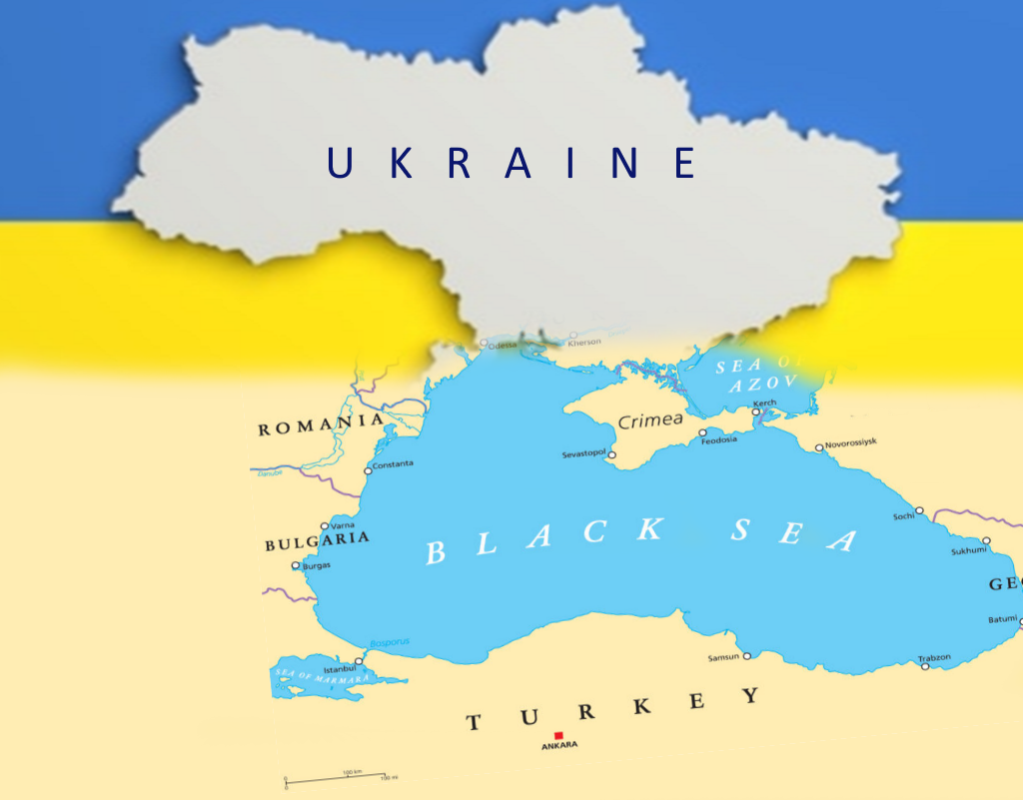
State Organization “Institute of Market
and Economic&Ecological Researches
of the NAS of Ukraine”
Scientific path, research activities, projects and prospects
2025

Slide 2

State Organization “Institute of Market
and Economic&Ecological Researches
of the NAS of Ukraine”
https://impeer.org.ua/, oss_iprei@ukr.net
Founded in May 1970, the Odessa Branch of the Institute of Economics of the Academy of Sciences was aimed at solving of problems of maritime transport development and related industries improving on basis of program-targeted planning, modeling of economic and ecological processes, economic research of marine resources, research of ecosystems
In 1991 Odessa branch of the Institute of Economics was transformed into The Institute of market problems and economic&ecological research of the National Academy of Sciences of Ukraine and new directions of the researches were started because of the intensification of the socio-political and economic life of the country, the expansion of opportunities for regional development, the search for solutions to new problems of strategic development of Ukraine
In 2021 transformed into the State Organization “Institute of Market and Economic-Ecological Research of the NAS of Ukraine” plays role of the Southern Scientific Center of the NAS of Ukraine and MES of Ukraine
Nowadays the Institute is the only academician economic-ecological research unit in the Southern Region of Ukraine, provides the scientific, organizational, informative, policy-making, consulting, business support for economic-ecological systems in context of post-war recovery and EU-integration

Slide 3

Research departments of the State Organization “Institute of Market
and Economic&Ecological Researches of the NAS of Ukraine”
https://impeer.org.ua/, oss_iprei@ukr.net
Market Mechanisms and Structures
Development of market relations, sustainable economic systems; market regulation mechanisms; value added chains
Transport Services
Market
Transport services market and promotion of the country's transit potential
Regional Economic Systems Development
Socio-economic performance, cohesion policy, cross-border cooperation in Ukrainian Black Sea region
Economic and Ecological
Development
of Seaside Regions
Aqua-productive systems, ecologization of economic development of Ukrainian Black Sea region
Economic Regulation
of Nature Management
Environmental economics, sustainable development, natural assets management
Entrepreneurship
Development
Entrepreneurship competencies development, revitalization, impact-entrepreneurship, digitalization
Integration of Science, Education and Business
Science, Education and Business Integration and cooperation, h innovatization of economic development

Slide 4
The Main Goals and achievements of the State Organization “Institute of Market
and Economic&Ecological Researches of the NAS of Ukraine”
Econology scientific direction design and development (economics of ocean-systems resources use) – founded in 1980s. Maritime Doctrine of Ukraine
Projects and Drafts of Laws On Special Conditions of Investment Activity achieving in depressive regions
Postulates of Regional Green economy development, entrepreneurship, digitalization, AI, open science
Numerous analytical reviews on strategic markets development, green economy, sustainable development, solutions for marine economy and aquaculture. Nature assets evaluation
Scientists of the Institute were and are consultants of governmental authorities (President of Ukraine, Prime Minister, Ministries of Economy, of Ecology, Transport and Infrastructure, Post-war Recovery Comission)
SDG-indicators adopted for Ukrainian regions, UN Green Industry Indicators Implementation Methodology
Cohesion Policy postulates for Ukraine recovery and Regional economic development
Methodology of Regional Innovative Development Strategies. Research infrastructures

Slide 5

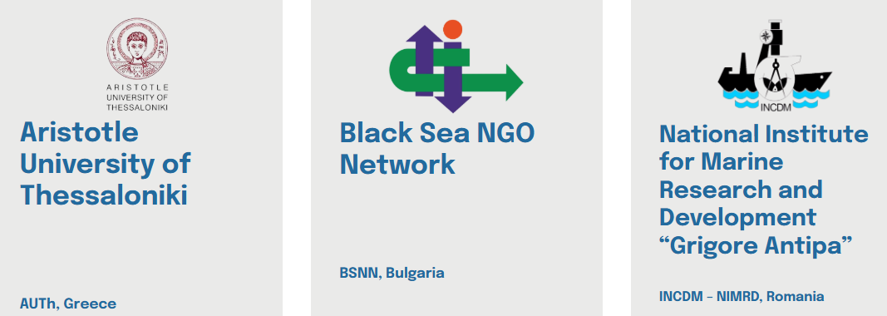
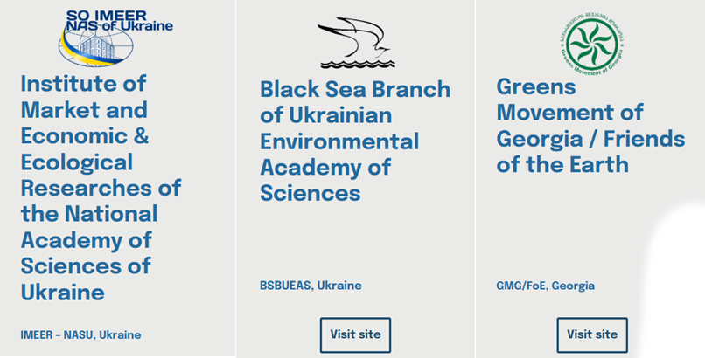
RESPONSE EMFAF-2023-PIA-FLAGSHIP-2-BLACK
RESPONSE is a cross-national 3-year long project (01/10/2023 – 30/09/2026), supported by the European Union within the framework of the European Maritime, Fisheries and Aquaculture Fund (EMFAF)
It aims to develop and test new training schemes and curricula for the monitoring, reporting, management and mitigation of marine pollution, with particular attention to pollution caused by armed conflicts. The stakeholders’ societal needs and requirements will drive the co-creation of the framework for the establishment and operation of an advanced training system

Slide 6
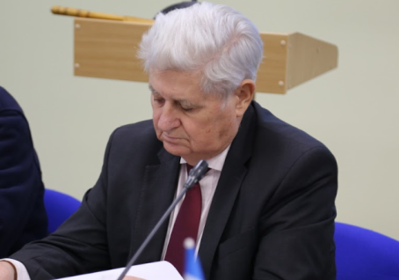
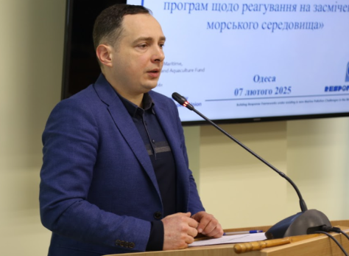
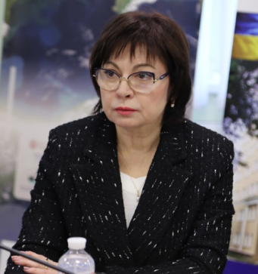
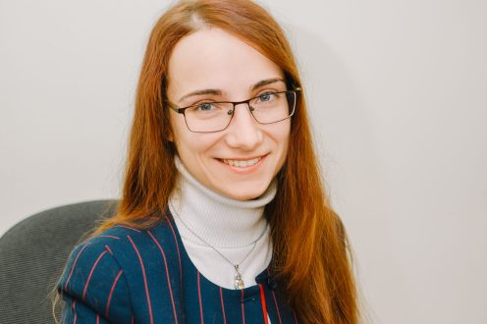
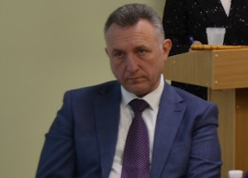
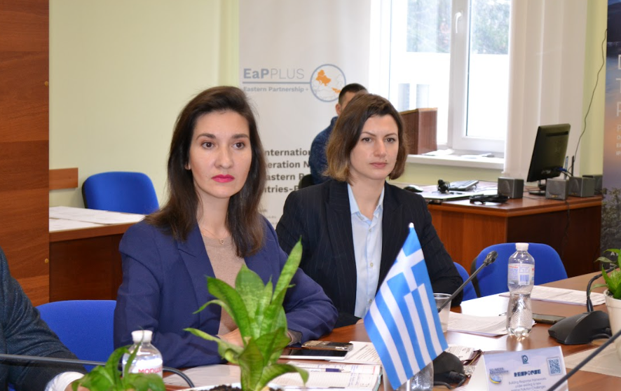
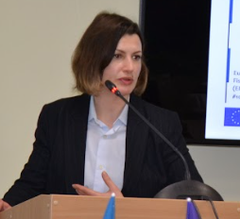
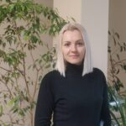
RESPONSE Project Team
Borys Burkynskyi Director of the Institute, Academician of the NAS of Ukraine, Professor, Doctor of Economics Chairperson | Oleksandr Laiko Deputy-director of the Institute for scientific work, Professor, Doctor of Economics Project Manager | Nina Khumarova Deputy-director of the Institute for scientific work, Corresponding-member of the NAS of Ukraine,Professor, Doctor of Economics Project Expert | Olga Golikova Scientific secretary of the Institute, Phd (Economics) Project Expert | Pavlo Bulanovich Deputy-director of the Institute, Phd (Economics) Project Expert
Olga Iermakova
Head of the Department of Economic and Ecological Development of Seaside Regions, Professor,
Doctor of Economics
Project Expert
Iryna Tsynalevska
Senior Research Fellow of Regional Economic Systems Development Department
PhD Econ,
Project Expert
Oleksandra Vorobiova
Senior Research Fellow of Economic Regulation of Nature Management Department
PhD Econ,
Project Expert

Slide 7
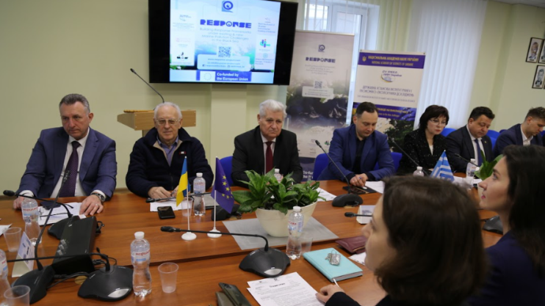
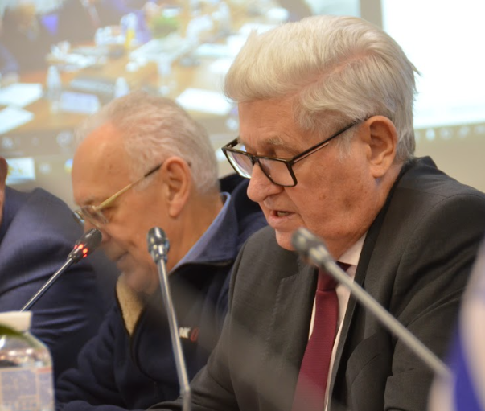
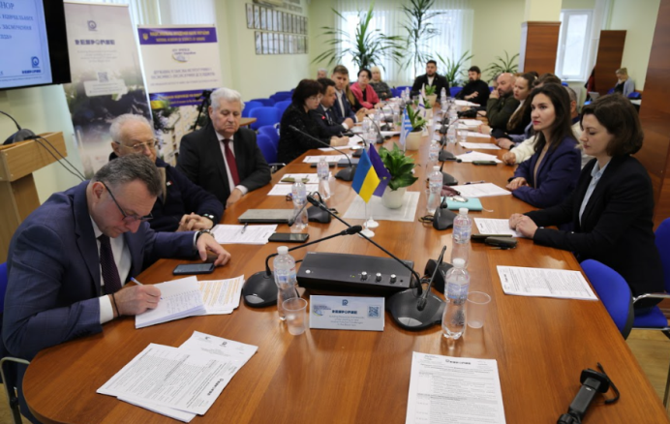
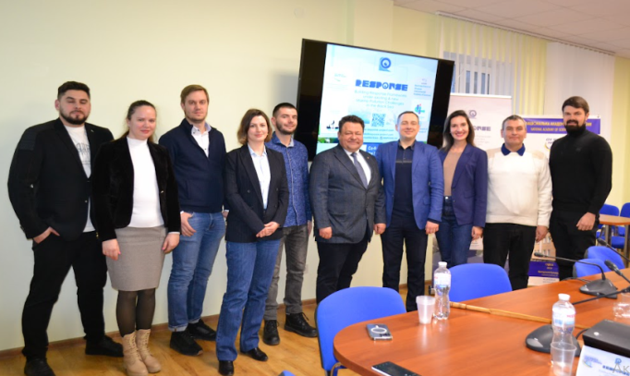
RESPONSE events
National Co-Creation Workshop Programme for Development of Training Programs for Responding to Marine Pollution (Odesa, Ukraine)

Slide 8
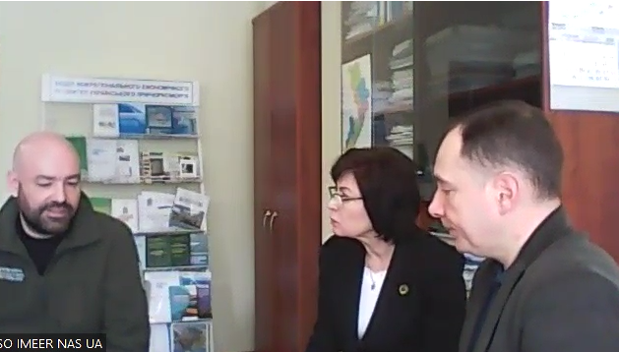
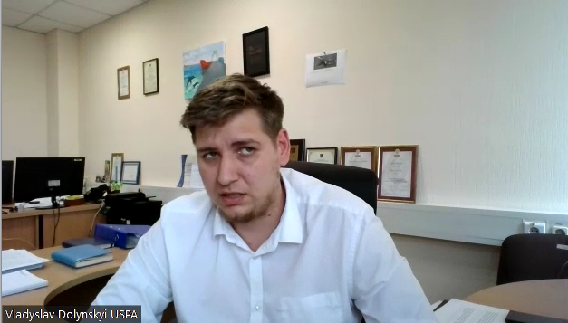
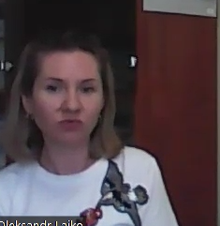
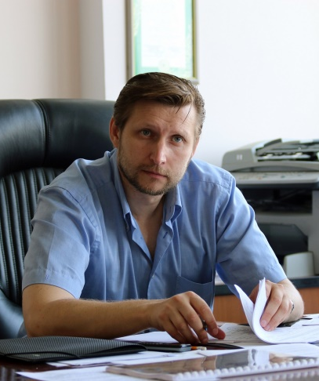
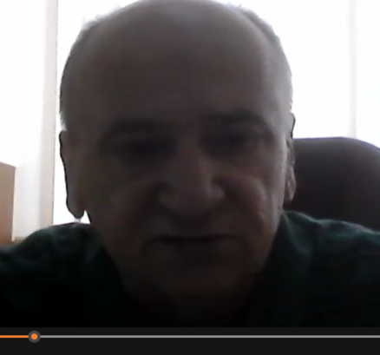
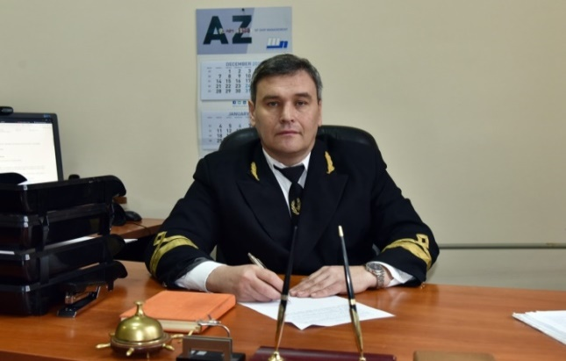
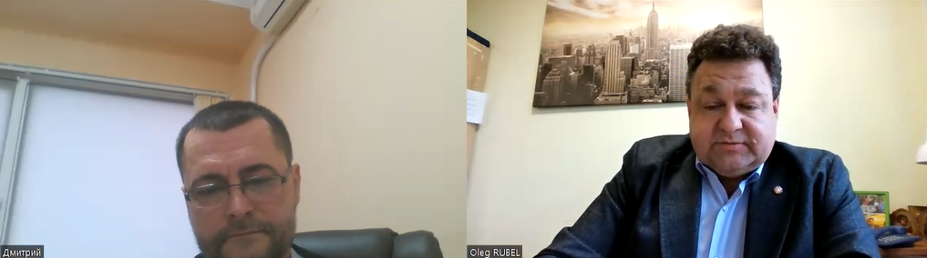
RESPONSE events
Stakeholders’ interviews (Odesa, Ukraine)

Slide 9





Prospects of the RESPONSE Project
Create improved curricula together with key stakeholders
A practical guide, a methodological guide for application
Digital toolkit for curriculum creation, delivery and updating
Regional Action Plan for Stakeholder Empowerment
Approbation and refinement of curricula
Organization of national workshops
Factual training for stakeholders
Achieve operational readiness for pollution response and risk assessment

Slide 10

Prospects of the Response
Networking and capacity building to transfer project results to other BS countries
Synergies with relevant complementary projects and initiatives
Study visits to BS countries
Involvement of key target groups (e.g. relevant stakeholders, policy makers, general public, wider scientific community)
Dissemination activities
Participation in scientific dissemination activities, Information via website and social media
Expand network of new stakeholders among BS organisations involved in marine pollution response
Sustainability of the RESPONSE project results

Slide 11
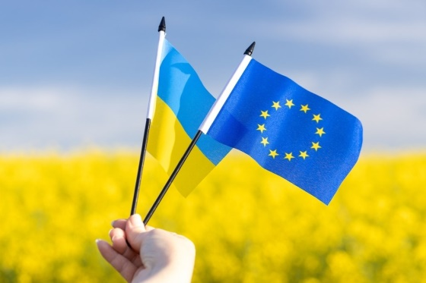
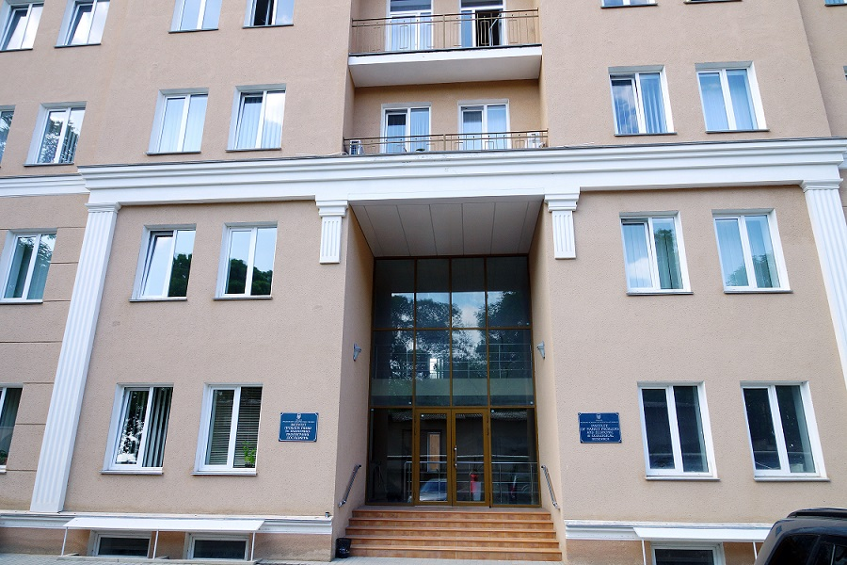
Thank you for you attention!
www.impeer.org.ua

